Slide 1





Pulse
Social Media and Marketing Multi- Agents Platform
Team Members:
Supervisor:
Abdelrahman Elattar
Dr.Mohamed Maher
Abdelrahman Omar
Hager Saad
Rana Mahmoud
Submission Date: 2025-11-21
CSAI School

Slide 2

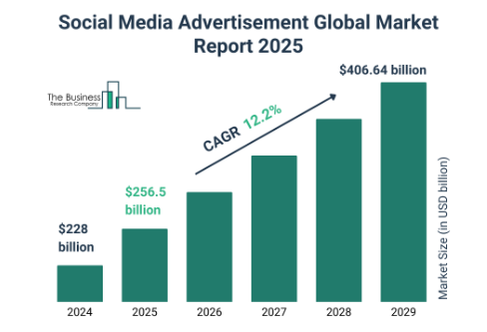
The Problem Statement
Problem Statement
Small businesses struggle with time-consuming, inconsistent social media management, leading to missed opportunities and reduced customer trust. Automated AI system ensures efficient scheduling, engagement, and analytics.
Impact
Increases marketing efficiency by automating tasks
Maintains consistent and authentic brand presence
Provides faster, personalized customer interactions
Improves audience engagement and satisfaction
Motivation
Automating social media management to boost efficiency, maintain brand consistency, and deliver personalized audience engagement.
Market Size Value In 2025 $256.5 billion
Revenue Forecast In 2034 $406.64 billion

Slide 3


The Proposed Solution
Proposed Solution Overview
Develop an Autonomous AI Social Media Multi-Agent Platform that automates content scheduling, audience engagement, and performance analysis, ensuring consistent brand presence and data-driven decision-making.
Key Features
AI Marketing Strategist for strategy and KPIs
Social Media & Performance Analyst for posting and insights
AI Customer Relationship Agent for personalized responses
Content & Market Authority Engine for smart content creation and optimization

Slide 4
Target Audience
Primary User Persona
Small business owners and e-commerce entrepreneurs who manage social media to promote their brand, engage customers, and drive sales.
User Characteristics
Small business owners and e-commerce entrepreneurs having time-constrained
Need efficient social media management. Aiming to increase brand visibility, engage customers effectively, and drive sales.
Uses multiple social platforms with limited marketing resources, and require automated tools that provide actionable insights and maintain brand consistency.
The Need
Automate solution to save time, ensure consistent social media presence, and make data-driven decisions.

Slide 5






Competitive Analysis
Feature
Pulse
Pomelli
Waxwing
Core Technology
Autonomous multi-agent system + performance analytics and strategy orchestration.
AI content generation based on business identity
AI-assisted marketing with human expert input
User Experience
End-to-end automation across strategy, content creation, engagement, and analytics.
Simple content creation workflow
Provides full marketing plan, content calendar, and strategy guidance
Integration Capability
Deep integrations with social platforms, CRM systems, and analytics APIs.
Focused on content creation; limited integrations
Partial automation; human intervention often required
Cost Structure
No cost in development period
still an experiment (no payment )
Higher cost for small businesses (49 $ per month with limited access)
Key Differentiators
Pulse redefines the market by doing what no competitor can: it doesn’t just assist, it autonomously runs the entire social media ecosystem. From real-time trend-driven content creation to personalized customer engagement, from intelligent scheduling to cross-platform analytics and performance prediction, Pulse replaces fragmented tools with a single coordinated multi-agent engine that plans, creates, responds, learns, and optimizes end-to-end delivering a level of automation far beyond Pomelli’s basic content workflows and Waxwing’s limited analytics and engagement capabilities.

Slide 6
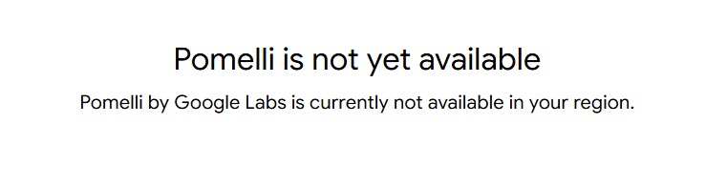
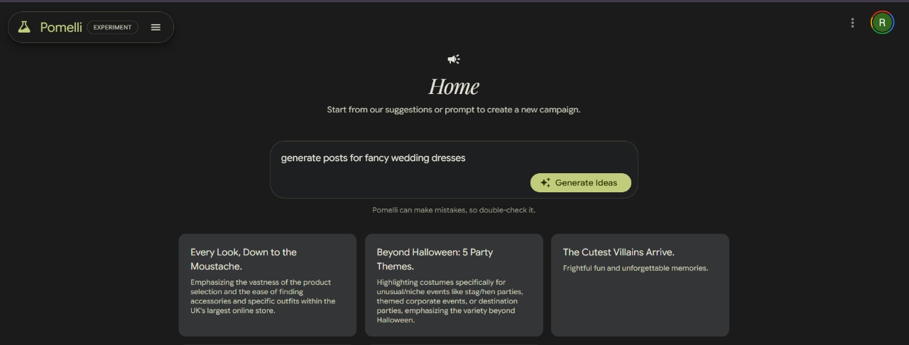

Competitive Analysis
Pomelli

Slide 7
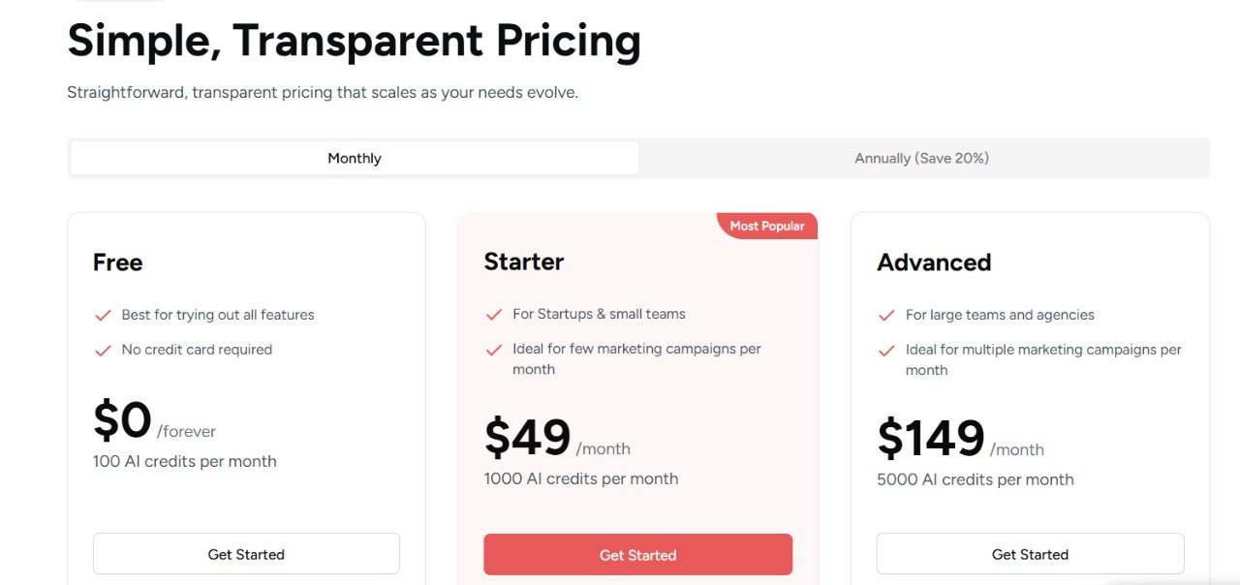
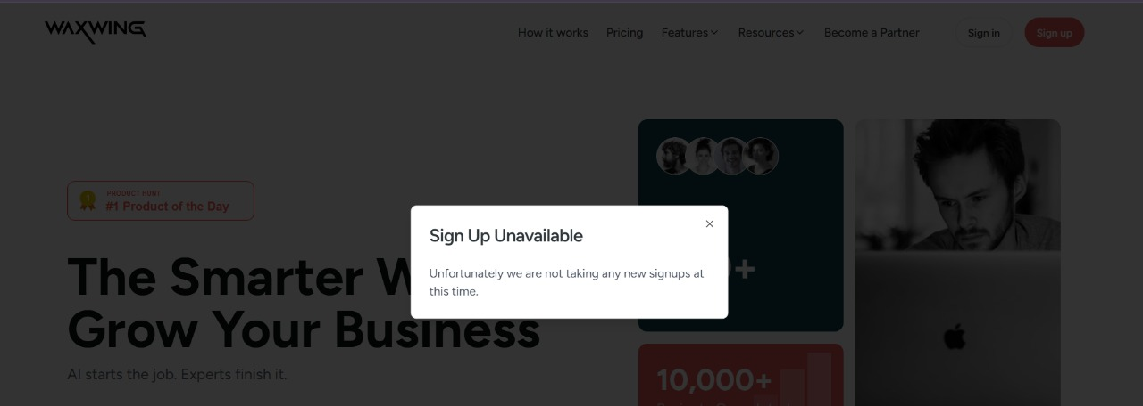
Competitive Analysis
WaxWing

Slide 8














Project Roadmap
Project Timeline
This section outlines the high-level plan for the remainder of the project, detailing key phases and milestones to guide development.
Current
Phase 2
Week 9
Testing
Phase 1
Phase 3
Development
Launch
Key Milestones
Week 10-12
Week 13-16
Week 17-18
Requirements gathering and initial design
Development of core features
Testing and refinement

Slide 9





Q&A
Thank You & Questions?
Team Contact Information
s-abdulrahman.elattar@zewailcity.edu.eg
+201021780496
We welcome your feedback and insights
CSAI School | Zewail City of Science, Technology and Innovation

